Slide 1


Active Learning with
Kate Harvey

Slide 2
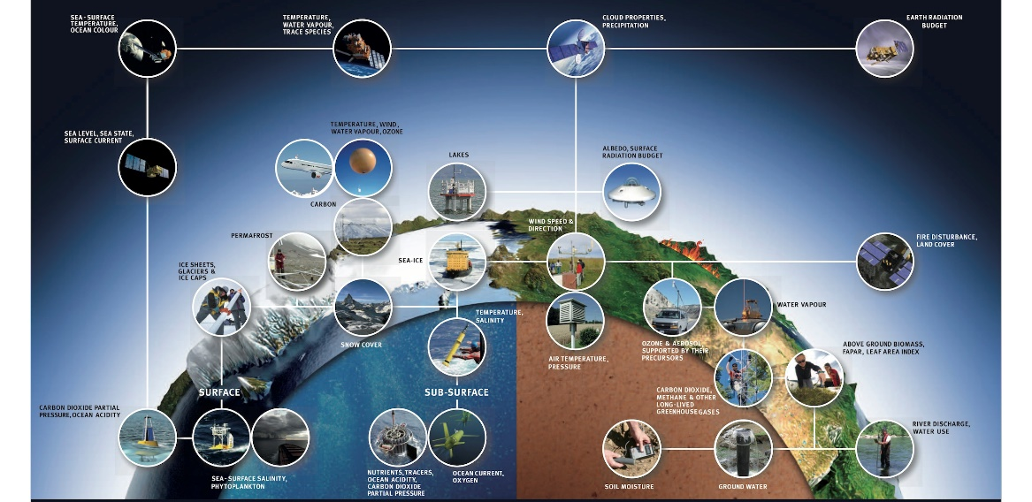
Global Climate Observing System (GCOS): ECVs
https://gcos.wmo.int/en/essential-climate-variables

Slide 3
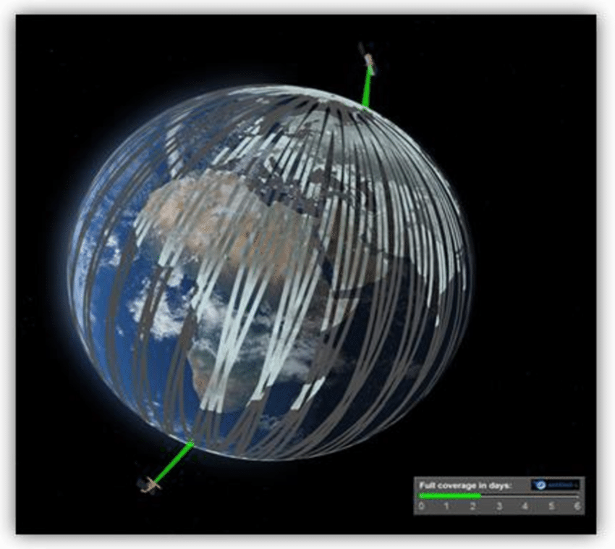
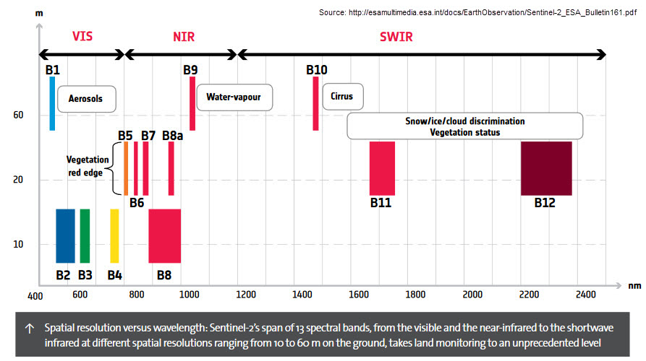
Sentinel 2 Mission
Multispectral Instrument (MSI)

Slide 4
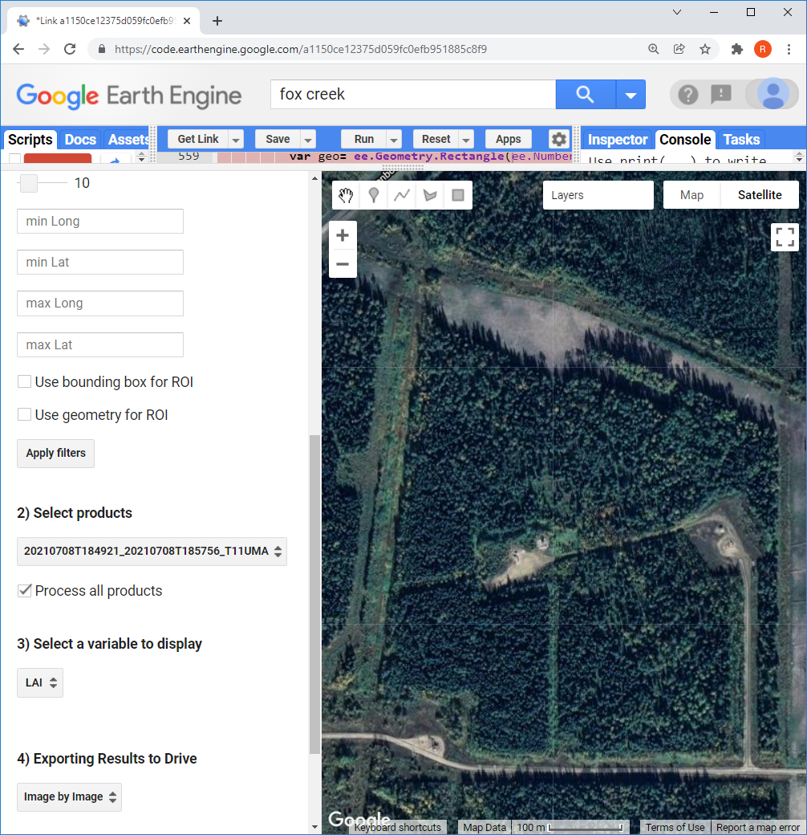
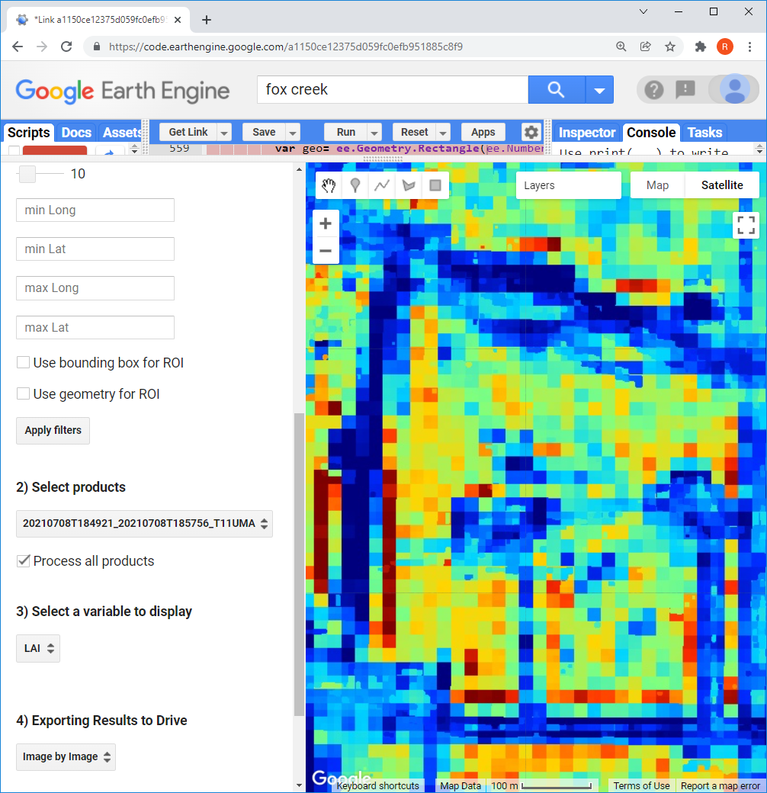
LEAF TOOLBOX (github/rfernand387/LEAF-Toolbox) Applies Simplified Level 2 Prototype Processor Using 20m S2 MSI bands

Slide 5
Question:
Can predictions be made using only the data from 10 m bands?

Slide 6
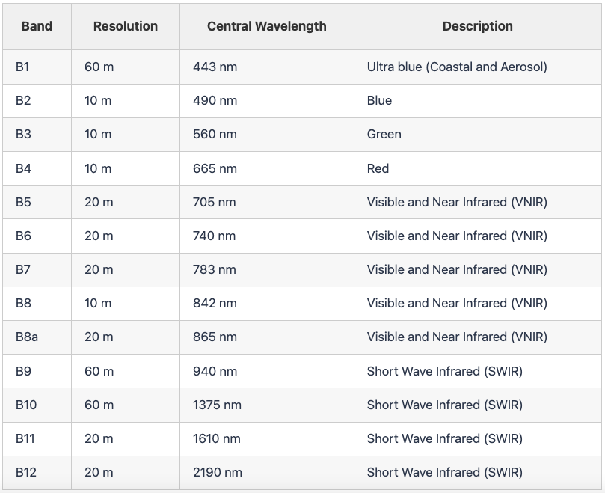
Approach
What is Active Learning? (also called Reinforcement Learning)
1
2
3
4
Populate
Filter
Train
Apply

Slide 7
Raw Image
SL2P10
SL2P
ALR (feature selection)
Regression Tree
Neural Net
Image Processing Workflow

Slide 8
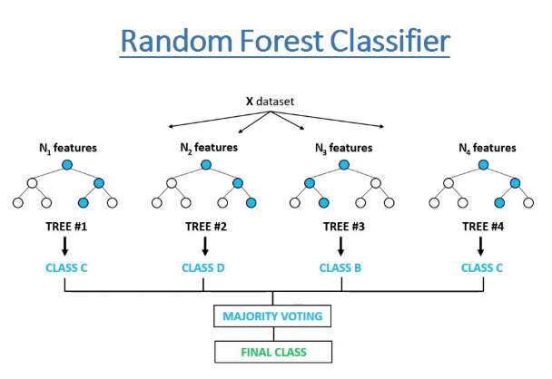
Testing
Three main variables:
Leaf area index (LAI)
Fraction of absorbed photosynthetically active radiation (fAPAR)
Fraction of canopy cover (fCOVER)

Slide 9
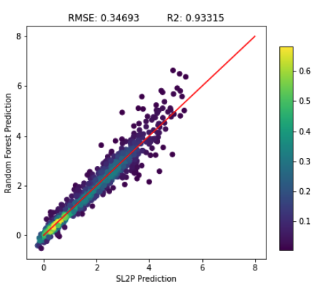
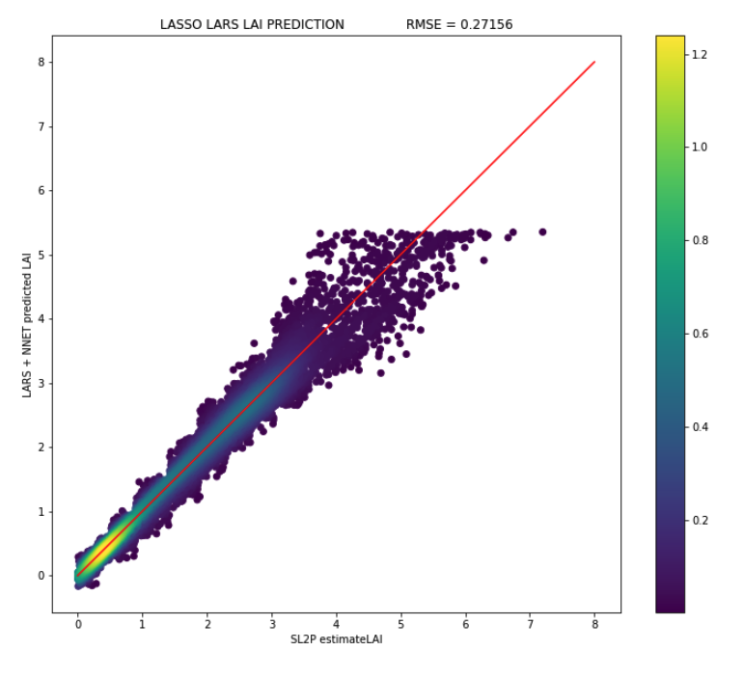
Results
SL2P vs. Regression Tree
SL2P vs. Neural Net
RMSE: ~0.15 - 0.3

Slide 10
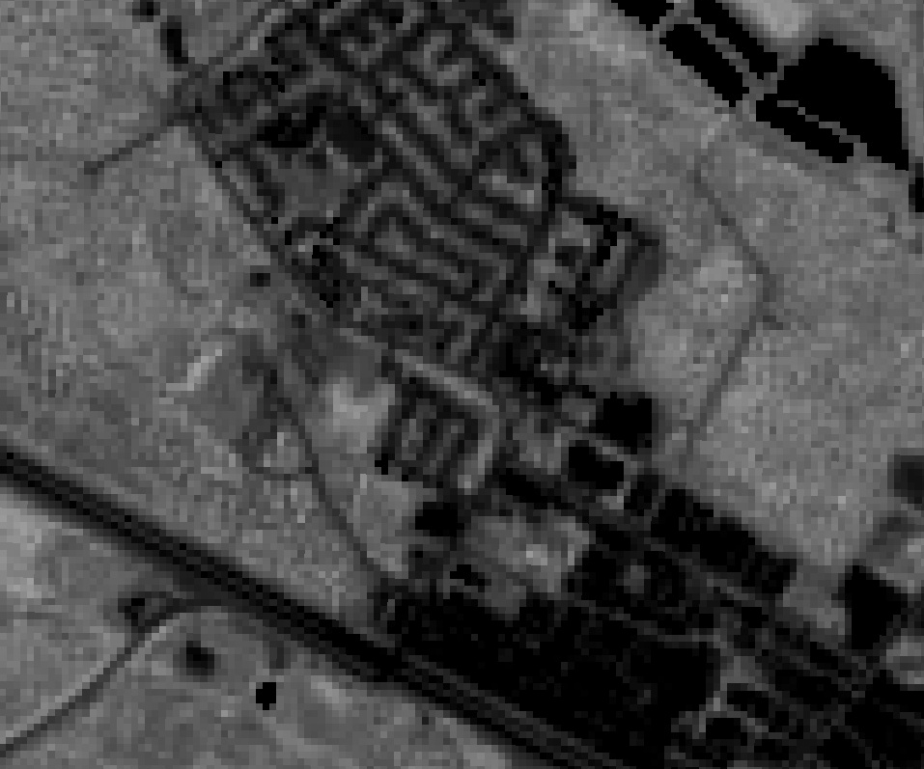
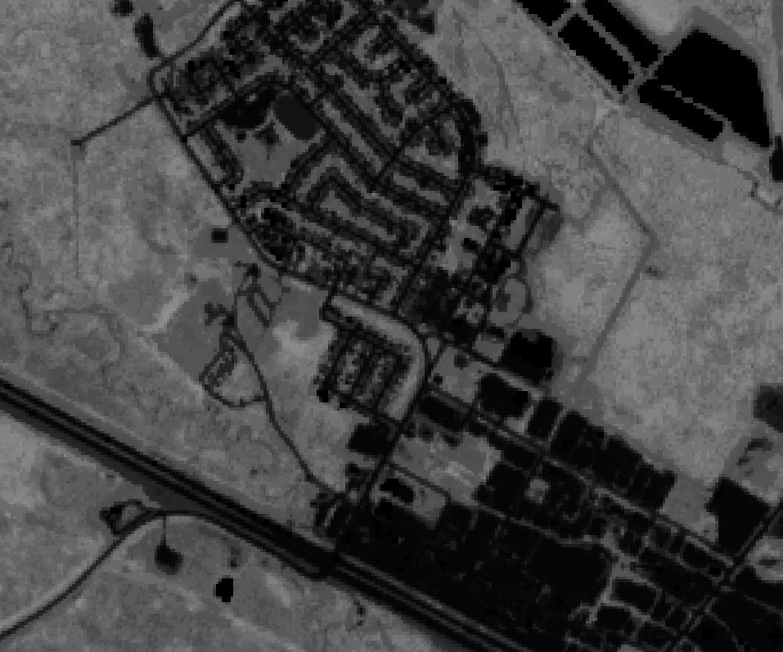
Example – Fox Creek, AB
20 m product
10 m product

Slide 11
Summary & Next Steps

